Slide 1
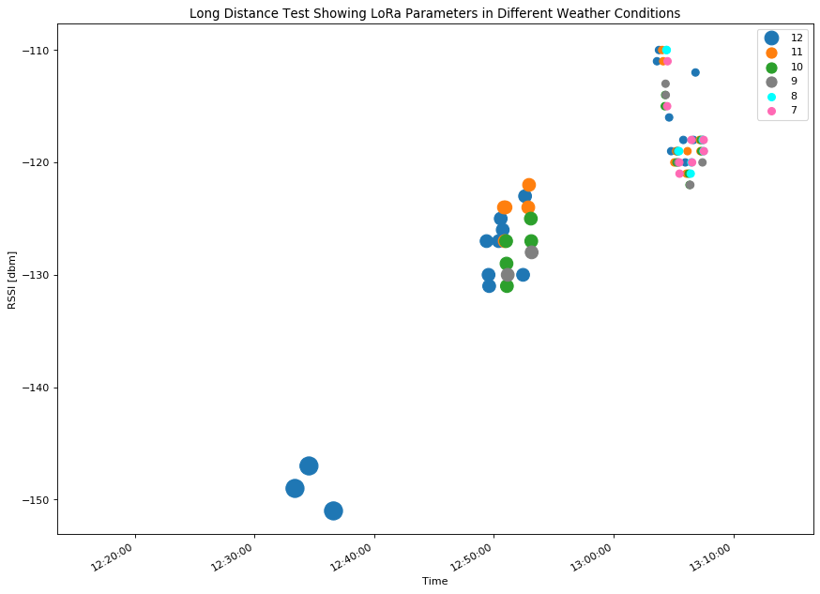
Sunny
Partly Cloudy
Dark Clouds with Fog
Rain

